Slide 1
Tide and Current Apps
Capt. Patricia Ensworth
Manhattan Sailing Club
March 18 2014

Slide 2
Research methods
Conduct e-mail survey of 22 skippers
Racing and cruising
Coastal and offshore
20 MSC members
1 San Francisco Bay
1 Gulf of Mexico
Analyze reviews, user forums, You Tube videos
Download, install, search for NYC data

Slide 3
Research findings
Only iPhone users (reason unknown)
Few on-the-water smartphone users
Connectivity problems
Loss of device in rough waters
Battery power drainage
Unreliability of predictive current data in actual conditions
Data privacy concerns
Four user profiles for T&C data
Traditionalists (Eldridge book only)
Desktop computer planners (websites)
Standalone app users (T&C only)
Integrated app users (T&C plus other functions)

Slide 4
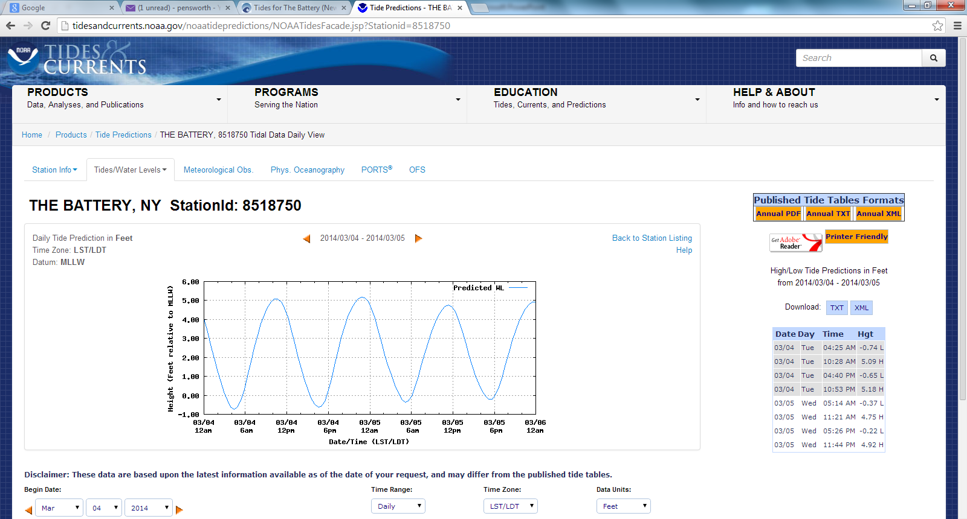
NOAA Tide Predictions website
http://tidesandcurrents.noaa.gov/noaatidepredictions/NOAATidesFacade.jsp?Stationid=8518750

Slide 5
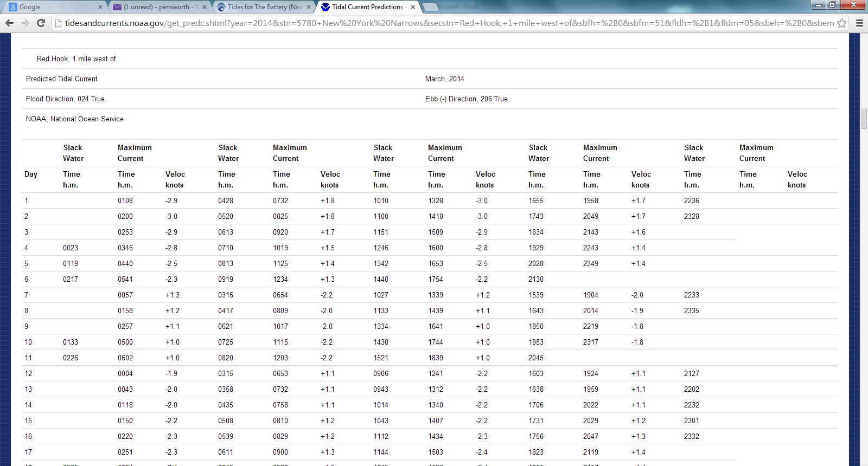
NOAA Tidal Currents Table website
http://tidesandcurrents.noaa.gov/get_predc.shtml?year=2014&stn=5780+New%20York%20Narrows&secstn=Red+Hook,+1+mile+west+of&sbfh=%2B0&sbfm=51&fldh=%2B1&fldm=05&sbeh=%2B0&sbem=39&ebbh=%2B0&ebbm=45&fldr=0.8&ebbr=1.2&fldavgd=024&ebbavgd=206&footnote=

Slide 6
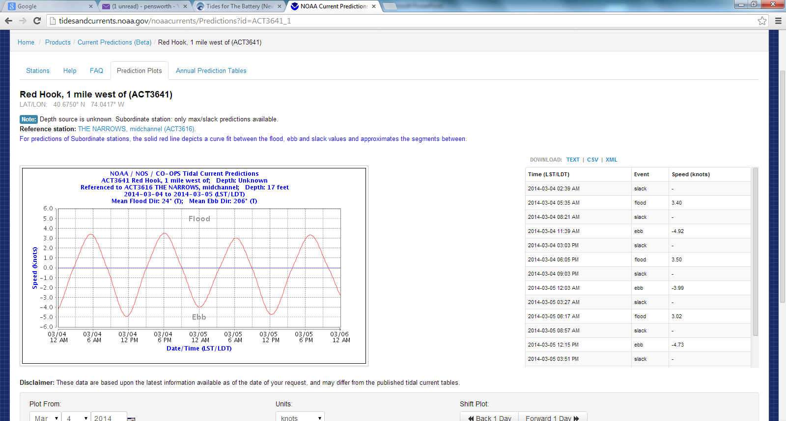
NOAA Current Predictions website
http://tidesandcurrents.noaa.gov/noaacurrents/Predictions?id=ACT3641_1

Slide 7
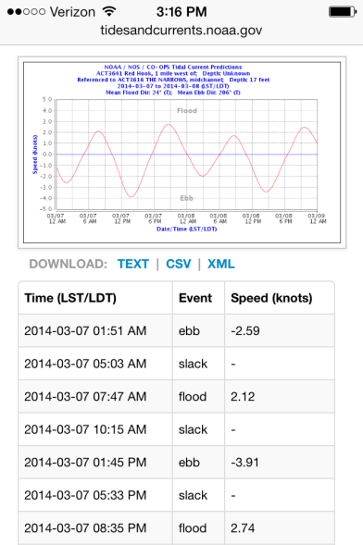
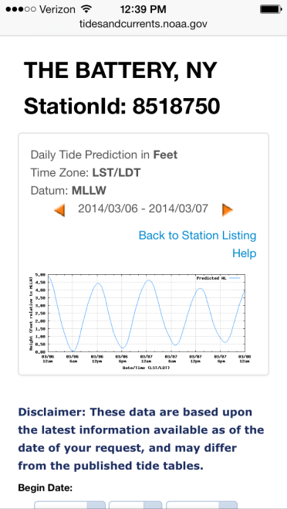
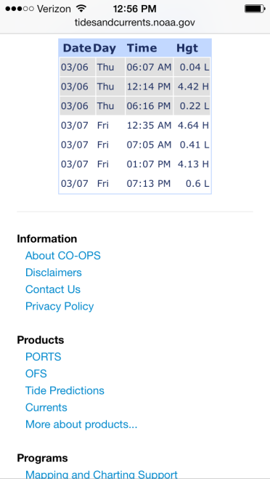
NOAA websites on phone
Tides
Currents

Slide 8
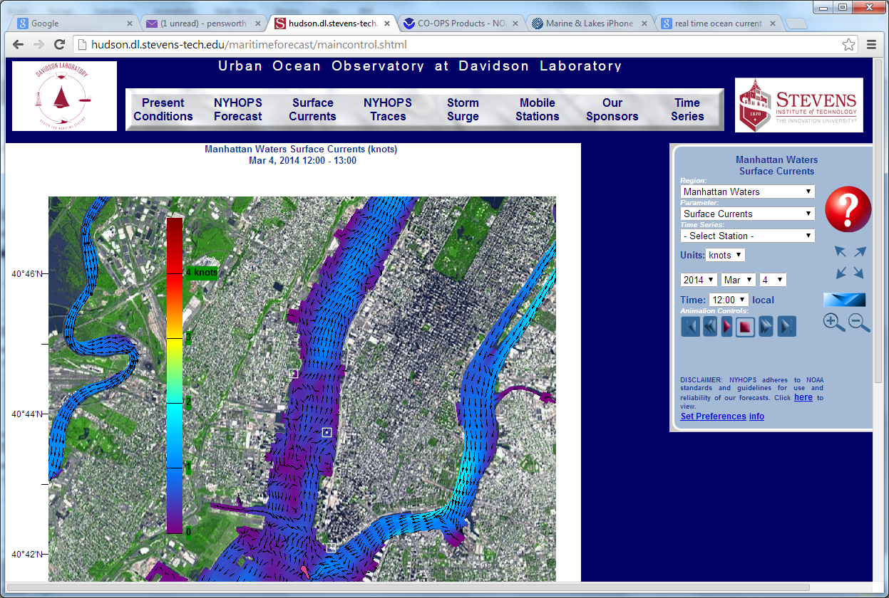
Stevens Institute website
http://hudson.dl.stevens-tech.edu/maritimeforecast/maincontrol.shtml

Slide 9
Stevens website on phone

Slide 10
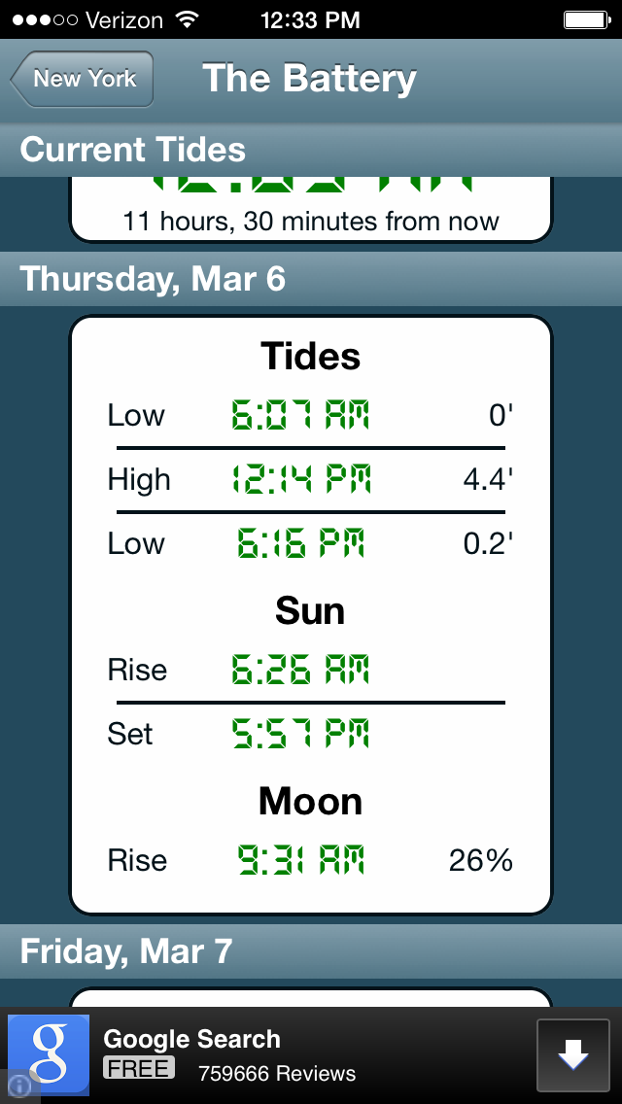
Tides: Tides Near Me
free

Slide 11
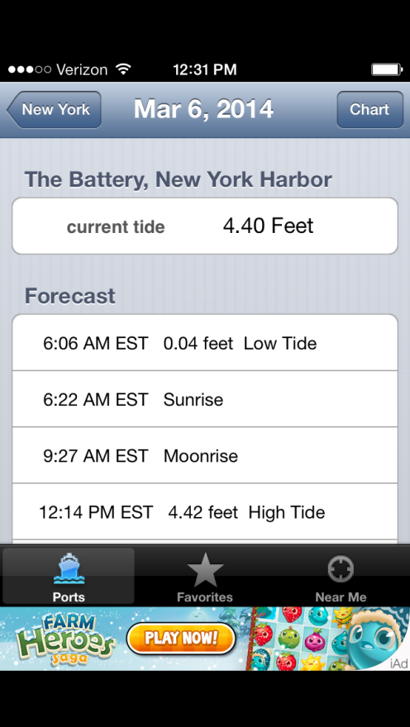
Tides: tideApp
free

Slide 12
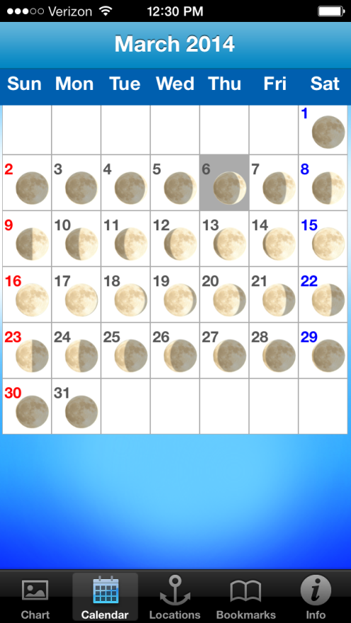
Tides: Tide Chart
free

Slide 13
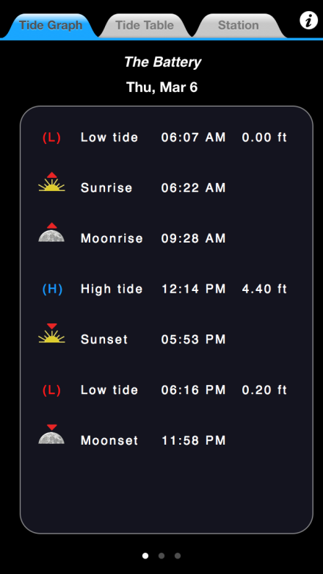
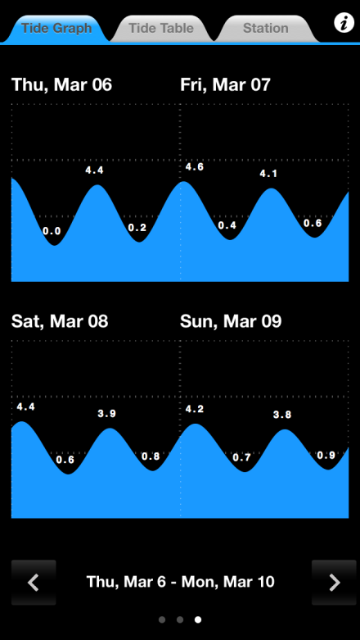
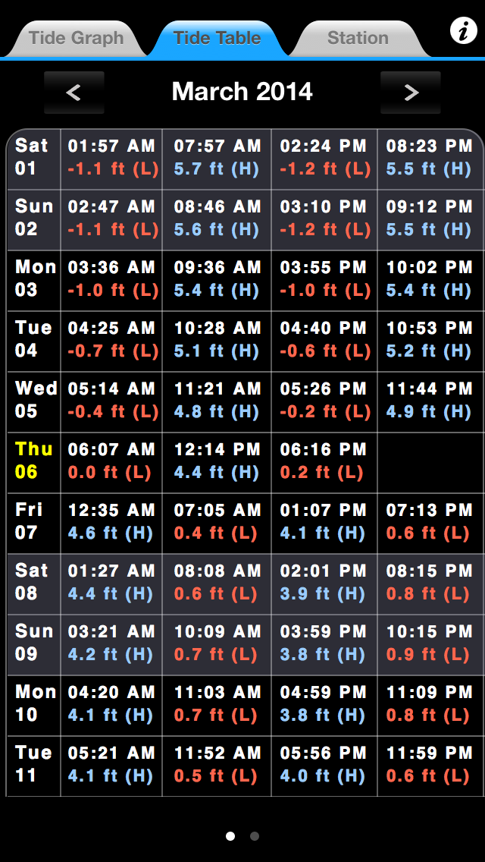
Tides: Tide Trac
$2.99

Slide 14
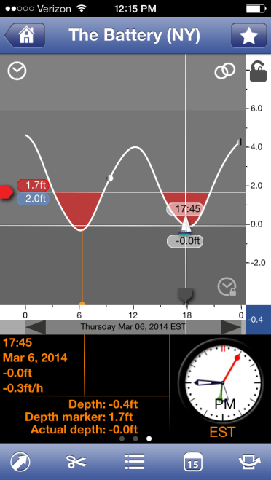
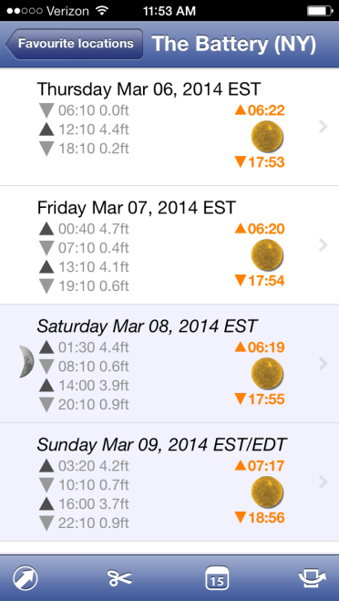
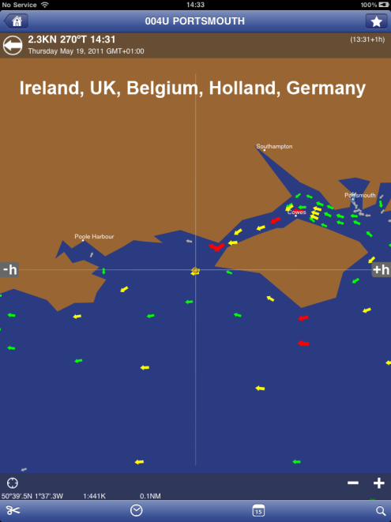
Tides: Tidesplanner
depth alert
current data available only for EU
$1.99 for tide data

Slide 15
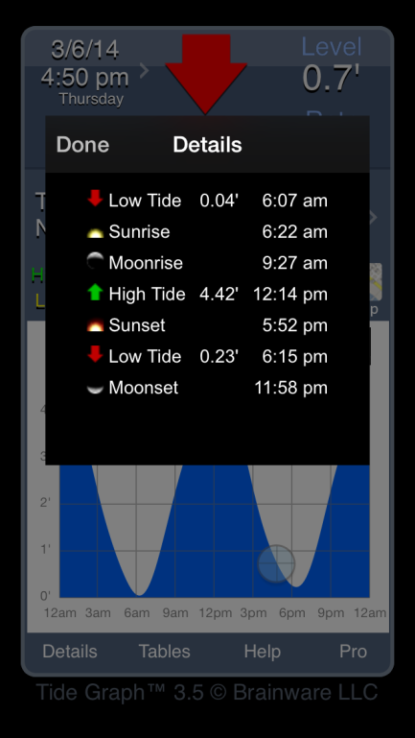
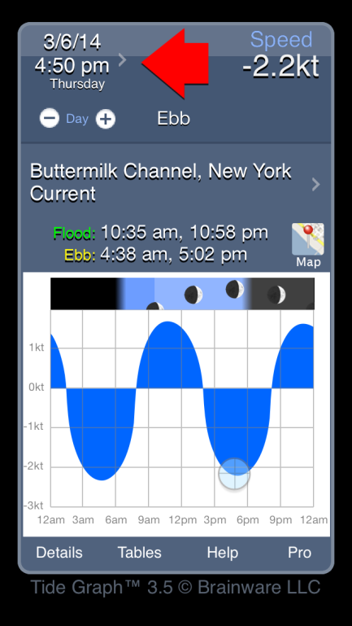
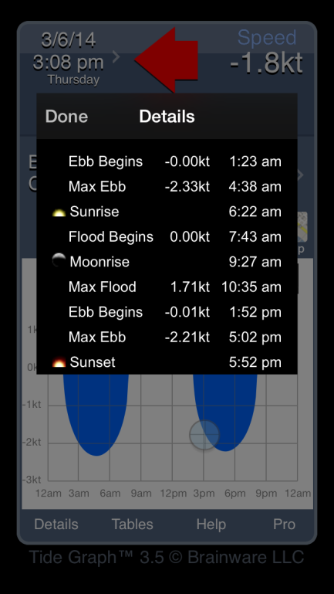
Tides + currents: Tide Graph
not all NOAA stations
$1.99

Slide 16
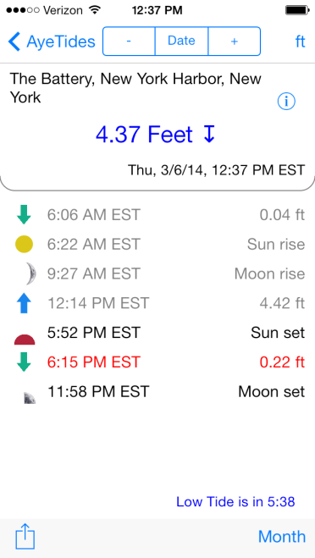
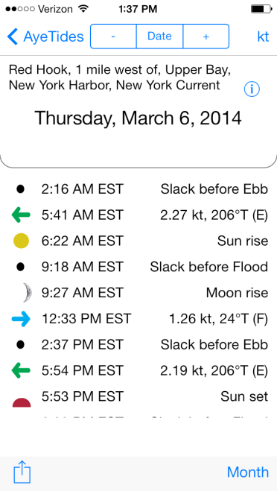
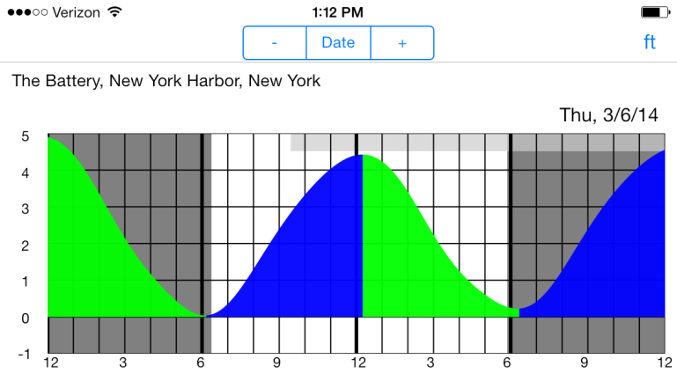
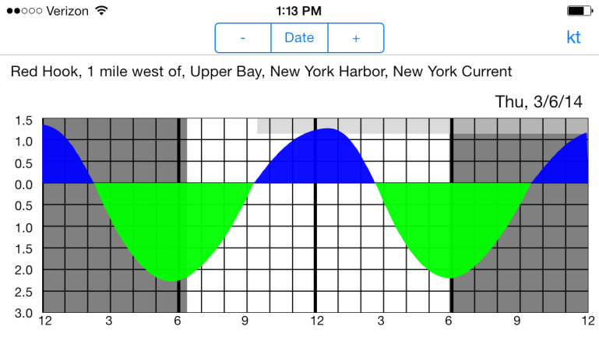
Tides + currents: Aye Tides
$7.99

Slide 17
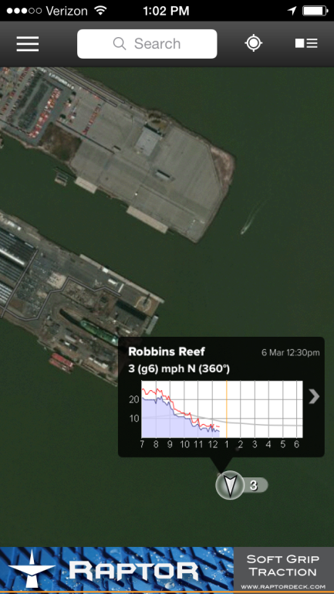
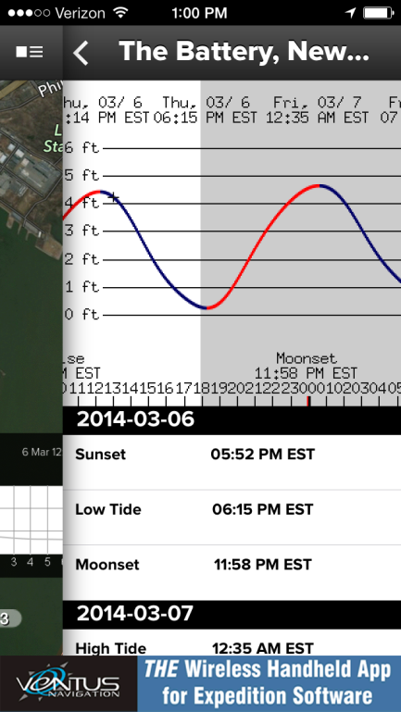
Tides + wind: weather apps
WindAlert and Sailflow
Windfinder Pro
select nearby tide stations
tide data source unknown
free
$1.99

Slide 18
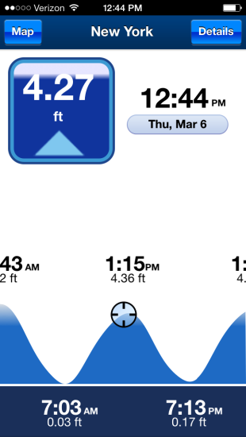
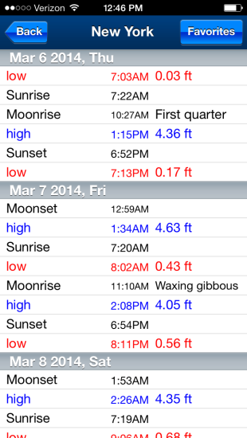
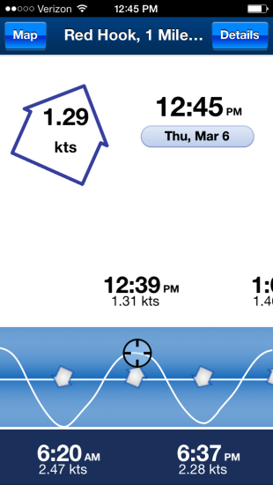
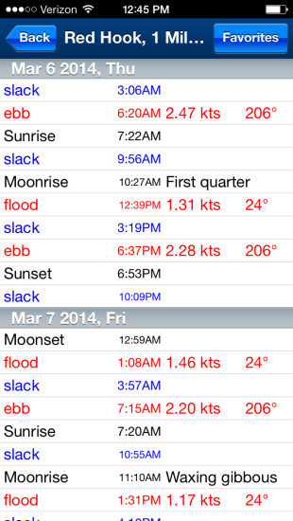
Tides, currents, charts: Navionics
$9.99

Slide 19
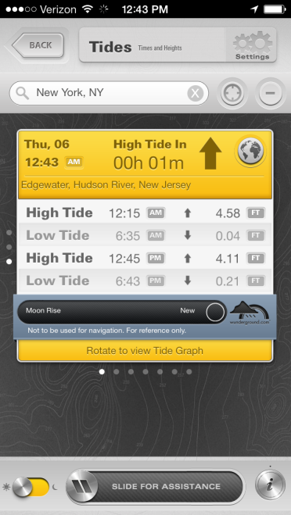
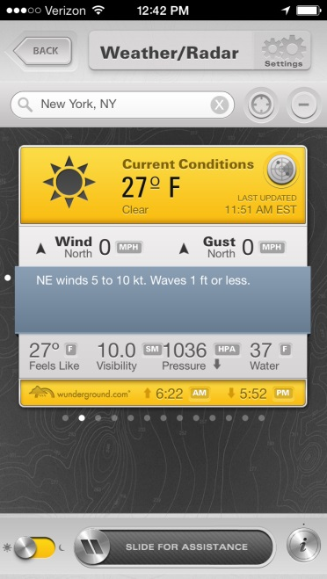
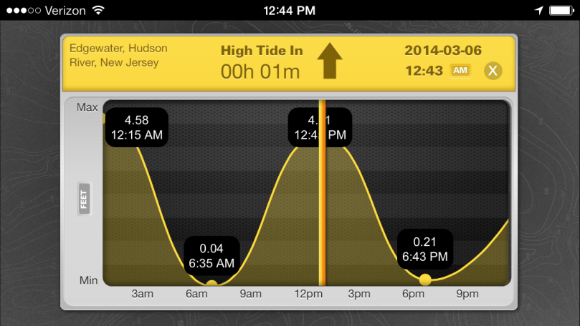
Tides, Weather, Compass, GPS, Emergency call: Sea Tow
free

Slide 20
Conclusions
Whether using paper tables, websites, or mobile apps, skippers should plan for the effect of tides and currents on a sail before they arrive at the dock.
Tide information is widely available and reliable in mobile apps.
Current information may look convincing in mobile apps but it is not so reliable due to the effects of weather.
Finding out the theoretical speed and direction of the current far from a major reference station is easier with a mobile app than with paper tables.
Anyone who is concerned about data privacy and security should not download a free app with ads.
Skippers should be mindful that on the water mobile apps can distract the crew, detract from the outdoor experience, and impair teamwork.
“Information underrepresents reality.” – Jaron Lanier in You Are Not A Gadget

