Slide 1
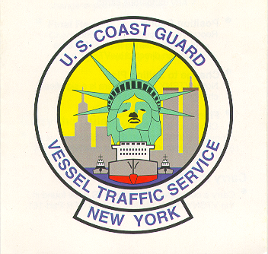
Vessel Traffic Service New York
UNCLASSIFIED

Slide 2
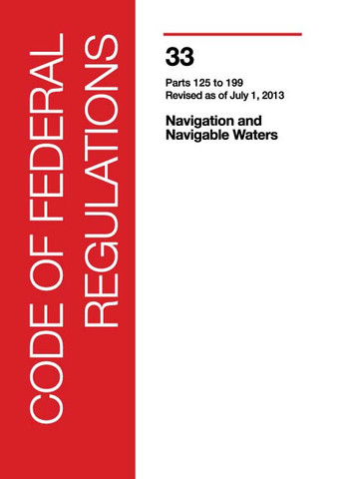
VTS Authority
Title 33 CFR Section 161
Ports and Waterways Safety Act of 1972
Oil Pollution Act of 1990
Maritime Transportation Security Act of 2002
UNCLASSIFIED

Slide 3
Our Mission
To maximize the safe and efficient use of the waterways of the Ports of New York and New Jersey.
UNCLASSIFIED

Slide 4
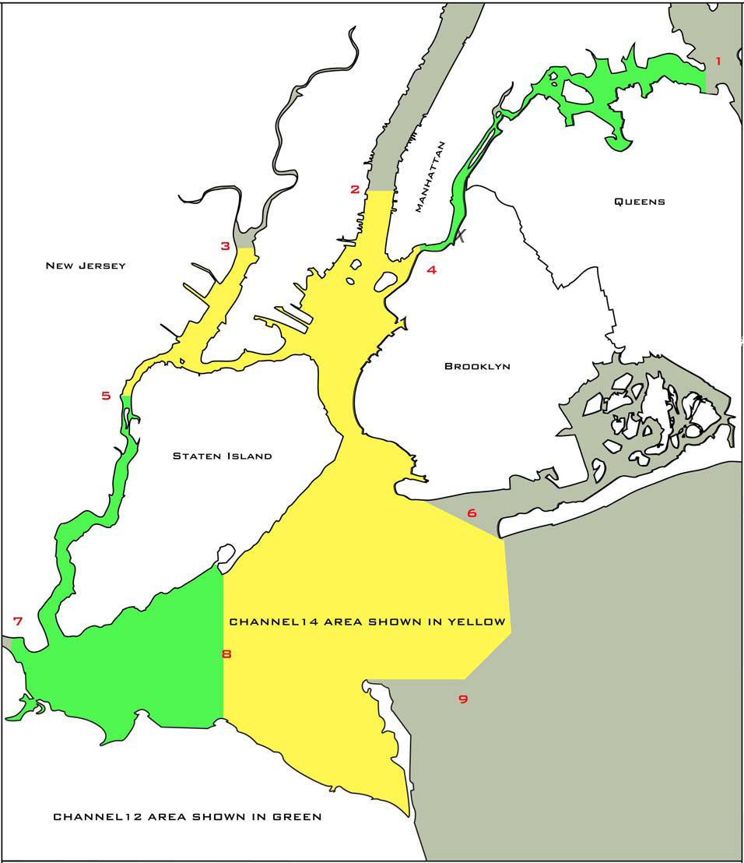
VTS Area Of Responsibility (AOR)
Boundaries
Raritan River Railroad Bridge
Lehigh Valley Drawbridge
Holland Tunnel Ventilators
Throgs Neck Bridge
Ambrose Channel entrance
Swash Channel entrance
Sandy Hook Channel entrance
UNCLASSIFIED
Notes:
The Area of Responsibility currently consists of the navigable waters of the United States bounded by the Verrazano-Narrows Bridge to the south, the Brooklyn Bridge to the east, and a line drawn east to west from the Holland Tunnel Ventilator shaft at latitude 40 degrees 43.7N and longitude 74 degrees 01.6W to the north. The Arthur Kill, the Kill van Kull to the Arthur Kill Railroad Bridge and Newark Bay to the Lehigh Valley Draw Bridge are also included.

Slide 5
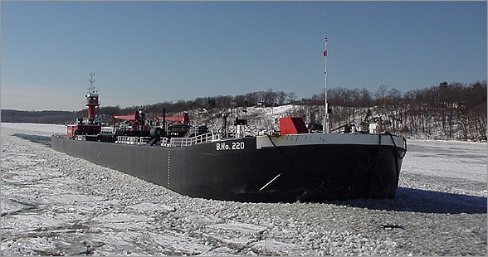
VMRS User:
Every power-driven vessel of 40 meters or more in length, while navigating
Every towing vessel of 8 meters or more in length, while navigating
Every vessel certificated to carry 50 or more passengers for hire, when engaged in trade
UNCLASSIFIED

Slide 6
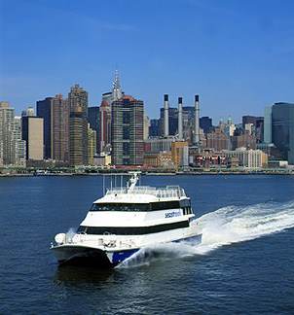
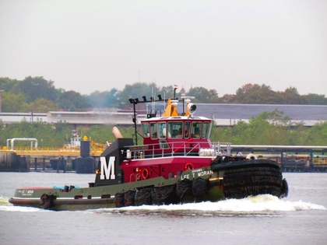
VTS User:
Every power-driven vessel of 20 meters or over in length while navigating
Every vessel of 100 gross tons and upward carrying one or more passengers for hire while navigating
Every towing vessel of 26 feet or over in length, while navigating
Every dredge and floating plant
UNCLASSIFIED

Slide 7
VMRS User vs. VTS User
All VMRS USERS are required to MONITOR the VTS frequency, PARTICIPATE in the VMRS and REPORT to the VTC.
All VTS Users are required to MONITOR the VTS frequency in accordance with the Bridge to Bridge Radiotelephone Act (33 CFR 26)
UNCLASSIFIED

Slide 8
What does the VTS do?
The primary function of VTS New York is to instill good order and predictability on the waters of the Ports of New York and New Jersey.
This is accomplished by coordinating vessel movements through the collection, verification, organization and dissemination of information.
Military and civilian personnel use Radar,
AIS data, VHF-FM radios, and low light CCTV
UNCLASSIFIED

Slide 9
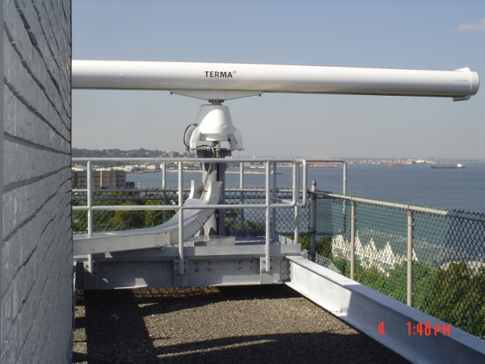
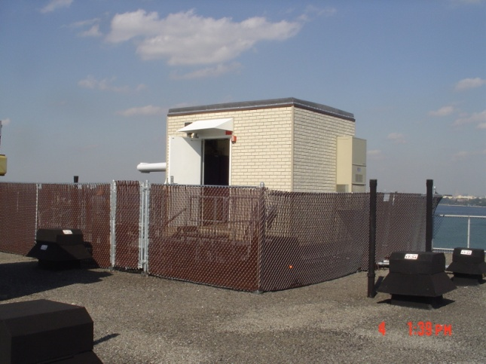
Remote Sensor Sites
19 Remote Sites
13 radars
26 closed circuit TV (CCTV) cameras
8 VHF-FM transceivers & guard radios
3 AIS towers
Remote Sites Strategically Placed throughout the Harbor
Complete coverage of the Vessel Traffic Service AOR
UNCLASSIFIED

Slide 10
What does the VTS monitor within the harbor?
The VTS is the eyes, ears, and voice of the harbor!
UNCLASSIFIED

Slide 11
Petroleum, Containers, Bulk Cargo
OCEANBORNE BULK and GENERAL CARGO (in metric tons)
 | TOTAL | IMPORTS | EXPORTS
2012 | 80,801,800 | 57,608,000 | 23,193,800
PORT OF NY/NJ CONTAINERS/TEUs
 | CONTAINERS | TEUs
2012 | 3,210,809 | 5,529,909
2012 BULK CARGO TONNAGE (Thousands of metric tons)
 | COMMODITY | VOLUME
Largest Import Volumes | Mineral Fuel, Oil | 31,558
Largest Export Volumes | Mineral Fuel, Oil | 7,204
UNCLASSIFIED

Slide 12
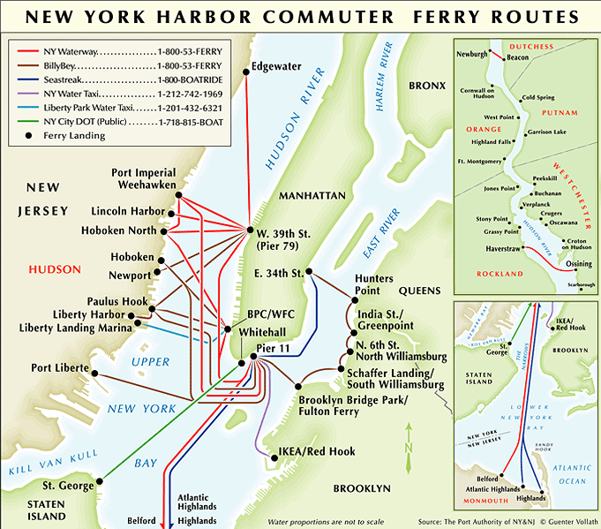
High Capacity Passenger Vessels and Commuter Ferries (PCMs)
800+ Daily Transits
75,000 daily riders aboard the Staten Island Ferry’s alone.
UNCLASSIFIED
Notes:
In addition to the Port’s Area Maritime Security cmte, we work with other sub-groups with particular interests & concerns. The Harbor Ops Cmte & the New York Harbor Private Ferries Planning Forum are two of which we deal with. General harbor & waterways operations in addition to security issues are addressed in these working groups.

Slide 13
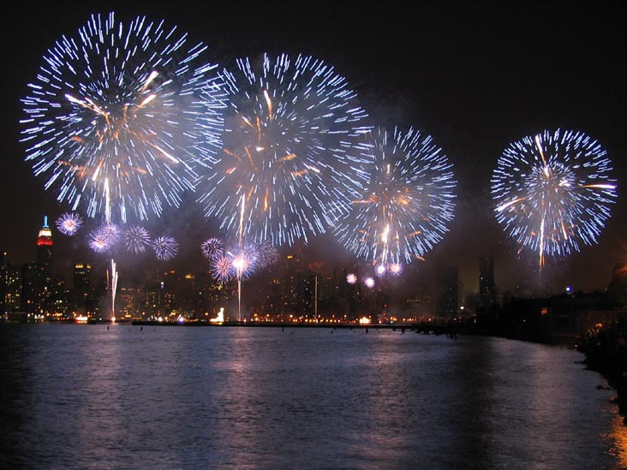
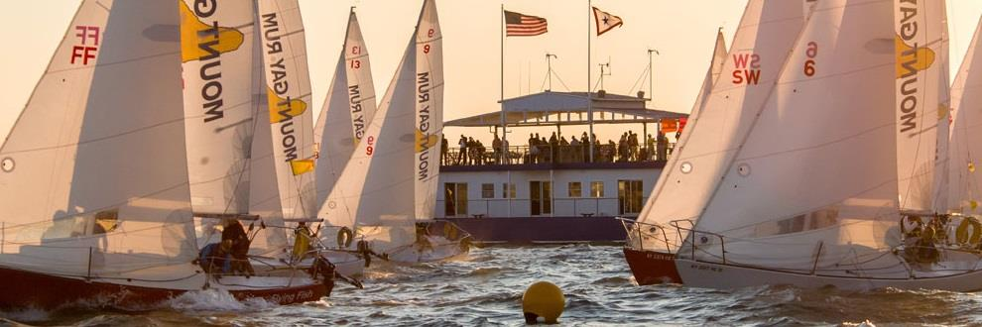
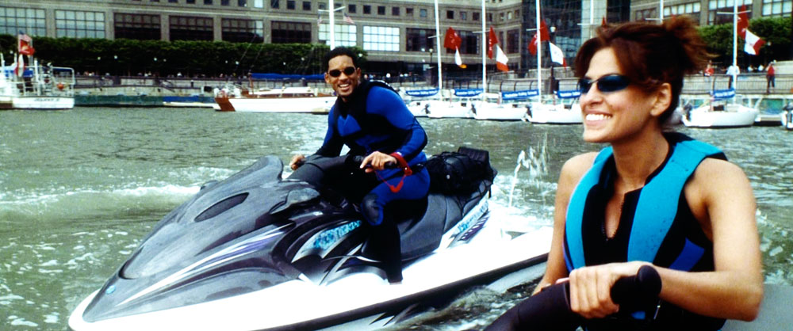
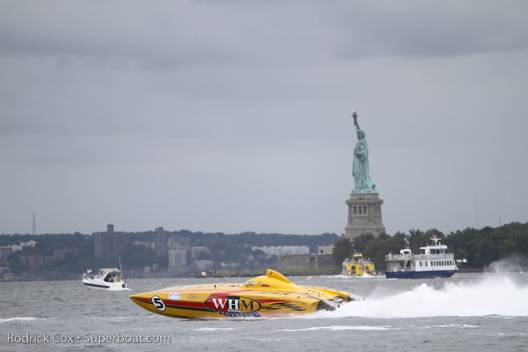
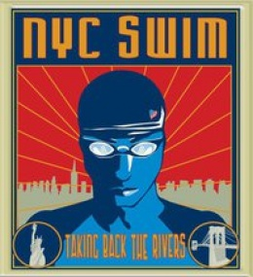
Marine Event Monitoring

Slide 14
Construction Monitoring

Slide 15
Average Daily Statistics in NY/NJ Harbor
TRANSITS:
150 Tug/Tow (Oil Cargo)
100 Tug/Tow (General Cargo)
40 Tanker Vessels
35 Freight/General Cargo Vessels
800 Ferries
10 Public Vessels
Average 1,000 to 1,500 total transits per day
OTHER DAILY INFO:
2 Incidents (possibilities include: Groundings, Anchorage Draggings, Allisions, Violations of Regs)
75-85 Pieces of Dredging Equipment Used in Dredging/ Blasting/ Construction Projects (intermittently)
UNCLASSIFIED

Slide 16
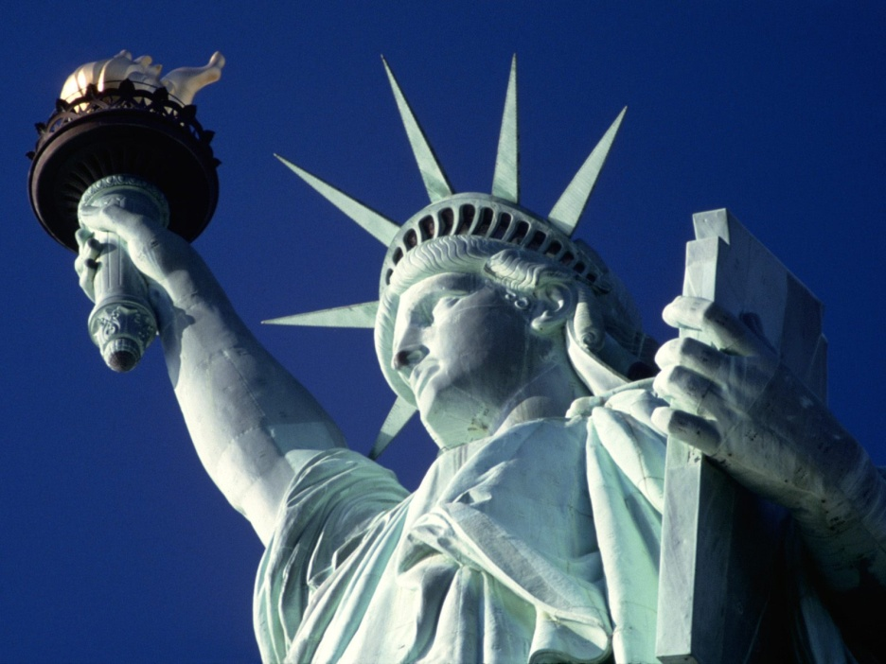
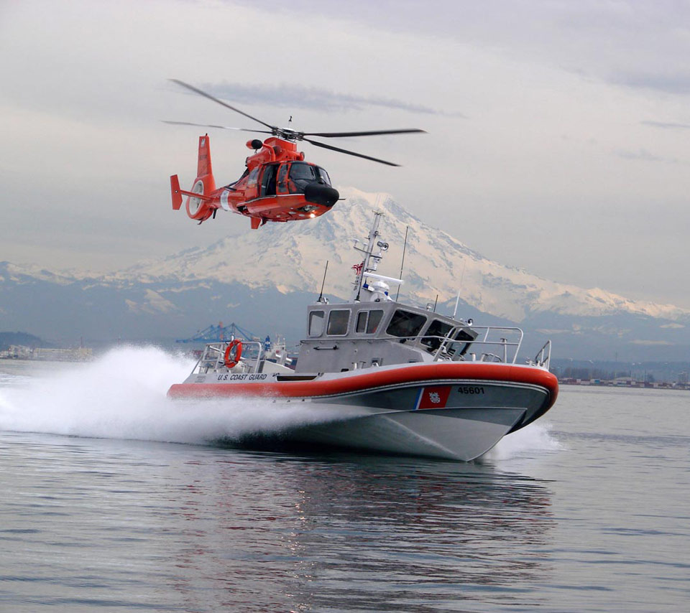
Security Zones (Appendix 8 of VTS User’s Manual)
Within 150 yards of Liberty and Ellis Islands
Within 25 yards of all bridge piers or abutments, overhead power cables and tunnel ventilators
Within 100 yards of all anchored or moored United States Coast Guard vessels
Within a 100 yard radius of any passenger ship, or vessel or barge carrying petroleum/chemical products in bulk
Within a 25 yard radius of every waterfront facility
500 yards around all U.S. Naval vessels in navigable waters of the United States.
UNCLASSIFIED

Slide 17
What you can do for the VTS
Report any hazardous, vessel operating conditions
Monitor the appropriate VTS frequency while navigating
Report marine casualties, ATON Discrepancies, pollution, or any other hazardous condition.
Proactively monitor VHF channel 13
Abide by the “rules of the road”
Carry the VTS regulations onboard
COMMUNICATE COMMUNICATE COMMUNICATE!
UNCLASSIFIED

Slide 18
Questions?
Vessel Traffic Service NY
212 Coast Guard Dr.
Staten Island, NY 10305 (718) 354-4088
UNCLASSIFIED

